Slide 1


Slide 2

FoxPlus Engineering
FOX
Plus
FoxPlus-A Update
and The Future of FoxPlus
October 18, 2025

Slide 3
FoxPlus Engineering
FOX
Plus
FoxPlus-A Update

Slide 4
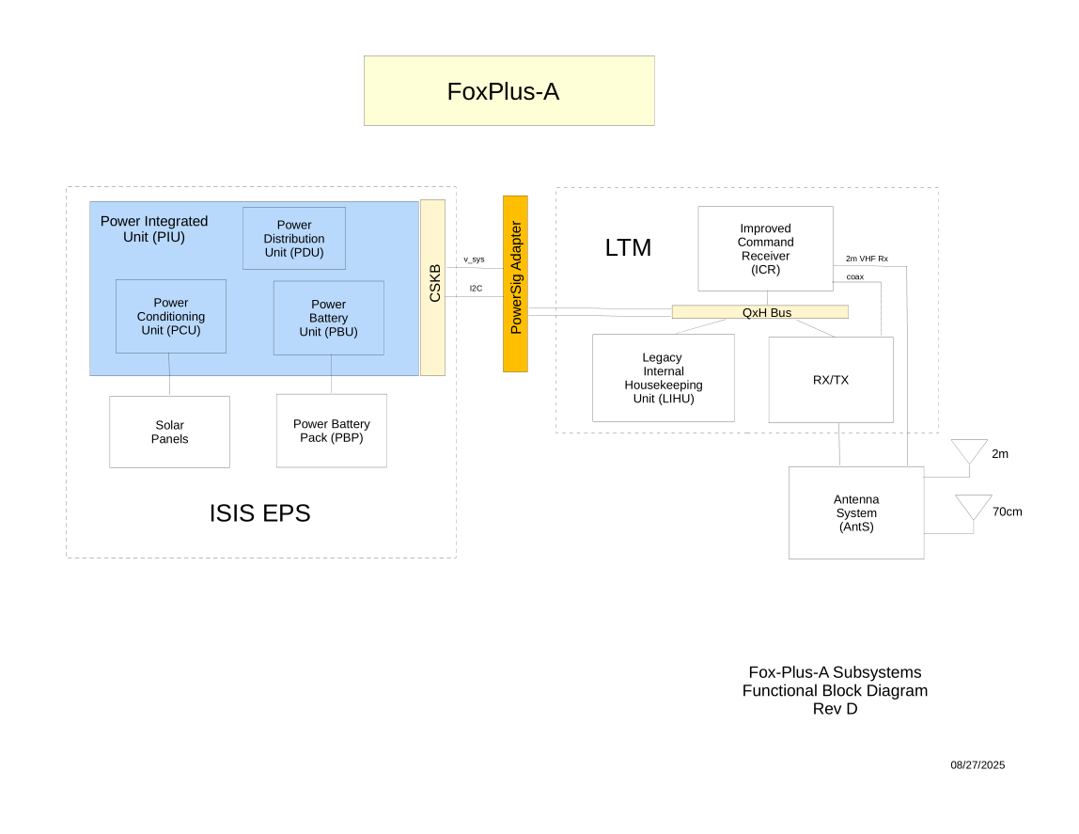
FoxPlus Engineering
FOX
Plus

Slide 5
FoxPlus Engineering
FOX
Plus
FoxPlus-A Update
ISISpace mounting holes do not line up with AMSAT ME-113 board mounting holes. A structural adapter was necessitated.
A 3D printed plastic adapter was prototyped and found good, so a metal adapter has been manufactured for the Engineering Model (EM)

Slide 6
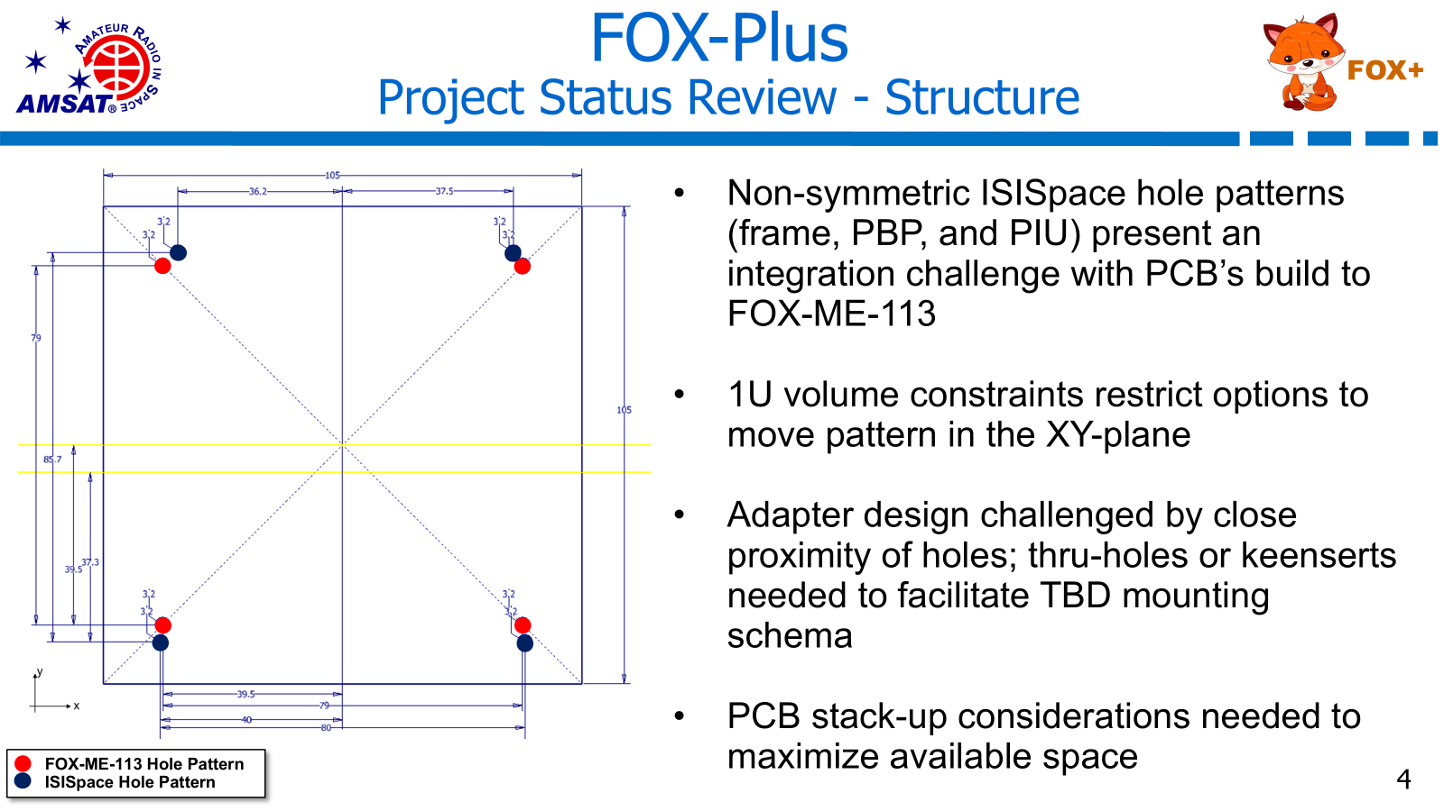

Slide 7
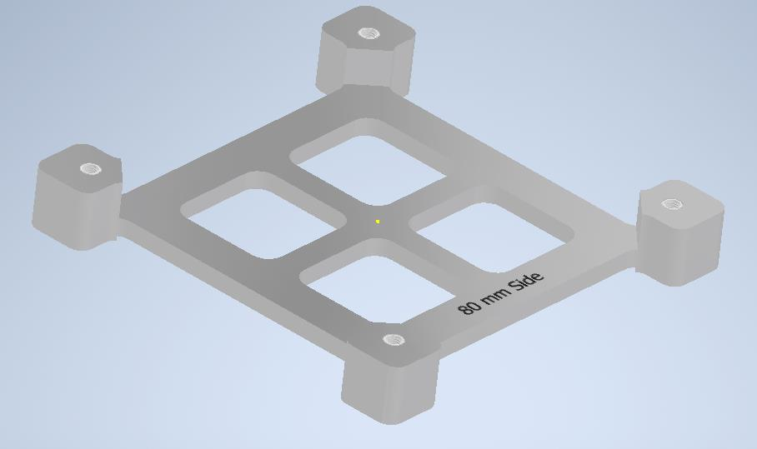
FoxPlus Engineering
FOX
Plus
Structural Adapter

Slide 8
FoxPlus Engineering
FOX
Plus
Power Signal Adapter (PSA)
The ISISpace Electrical Power System (EPS) power and I2C signals had to be connected to the AMSAT stacking connector. The PSA board was prototyped and is working. A 2 layer version has proved fit and function. A 4 layer version is being built for EM.

Slide 9
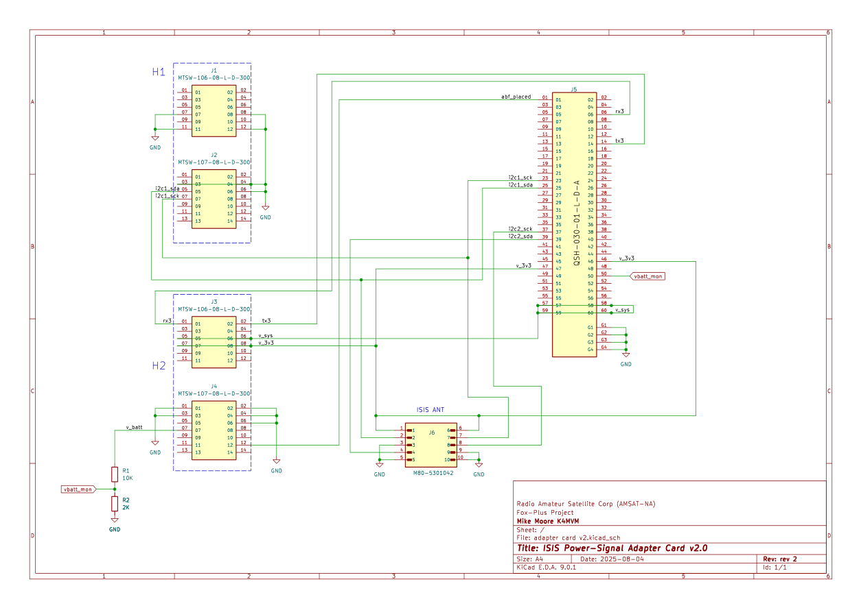
FoxPlus Engineering
FOX
Plus
PSA Schematic

Slide 10
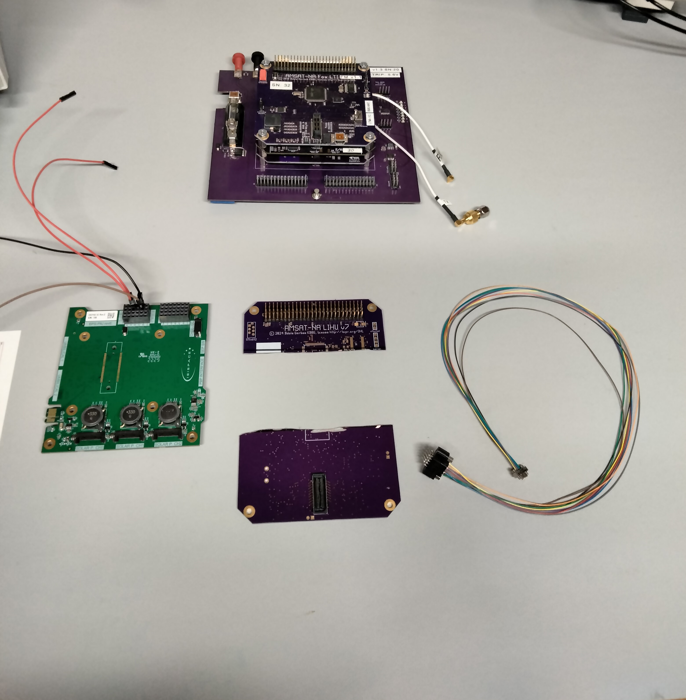
FoxPlus Engineering
FOX
Plus
PSA 2 Layer Prototype

Slide 11
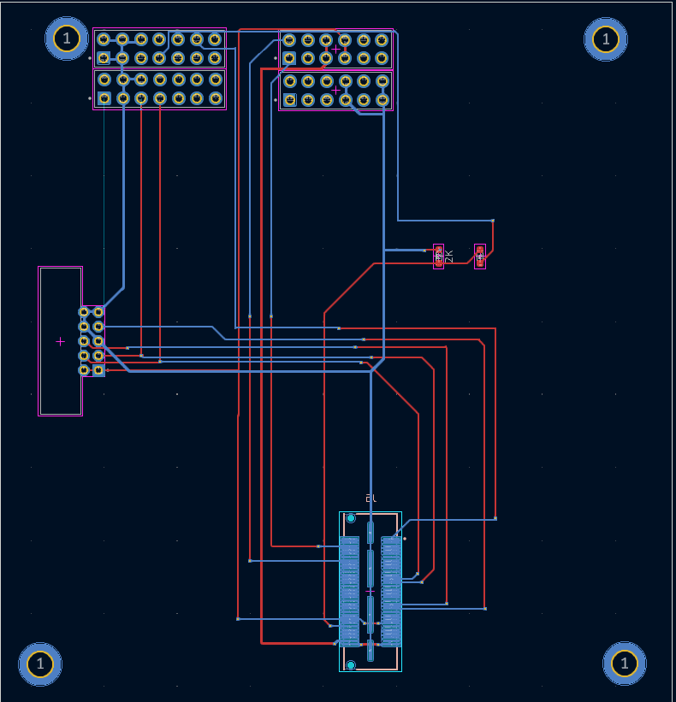
FoxPlus Engineering
FOX
Plus
PSA 2 Layer Prototype

Slide 12
FoxPlus Engineering
FOX
Plus
Structural / Mechanical
Cabling / wiring routing within the cubesat
CubeSat physical structure
Mechanical Adapter for ISIS frame to AMSAT board dimensions has been prototyped
PSA connectors pins too long. Mike got shorter pin connectors as samples, mounted them and shipped them to Andrew. They worked.
Andrew has been working on cabling in Inventor
And has new hardware?

Slide 13
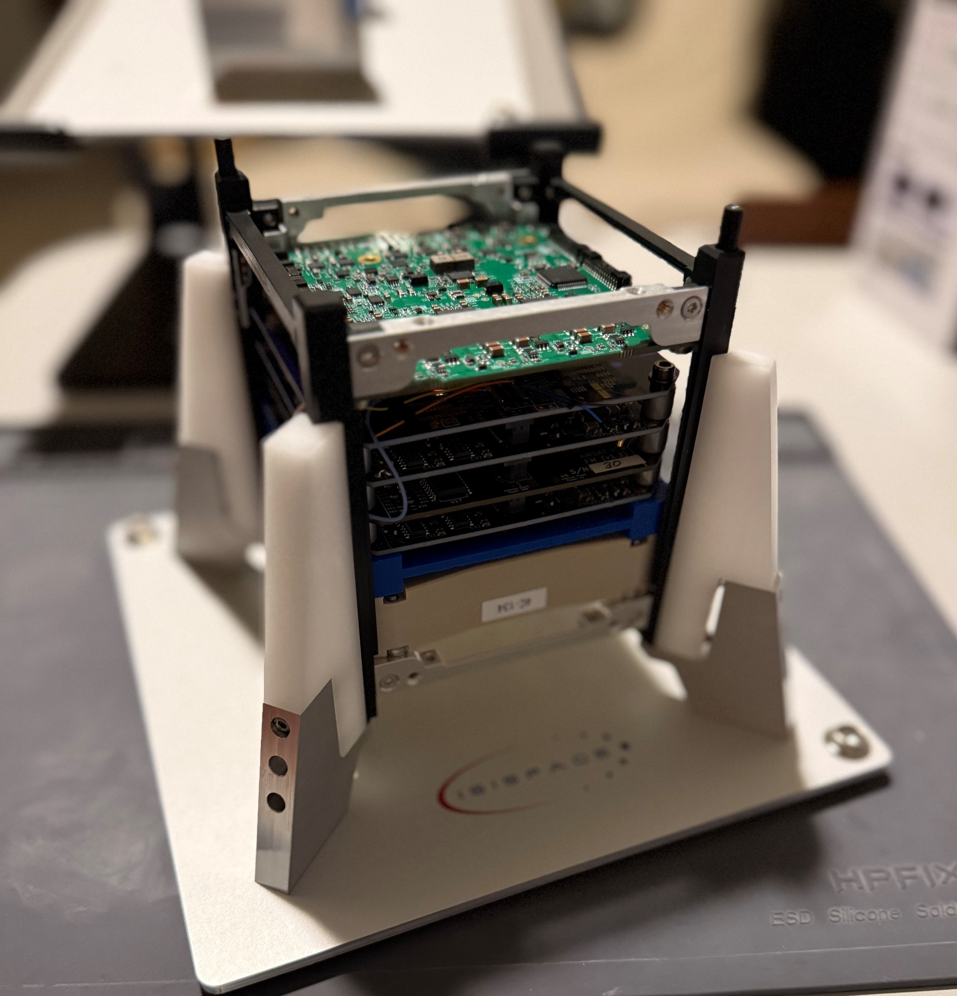
FoxPlus Engineering
FOX
Plus

Slide 14
FoxPlus Engineering
FOX
Plus
FoxPlus Flight Software
Burns is working on FoxPlus Telemetry and Flight software
Very good progress. 80% complete?

Slide 15
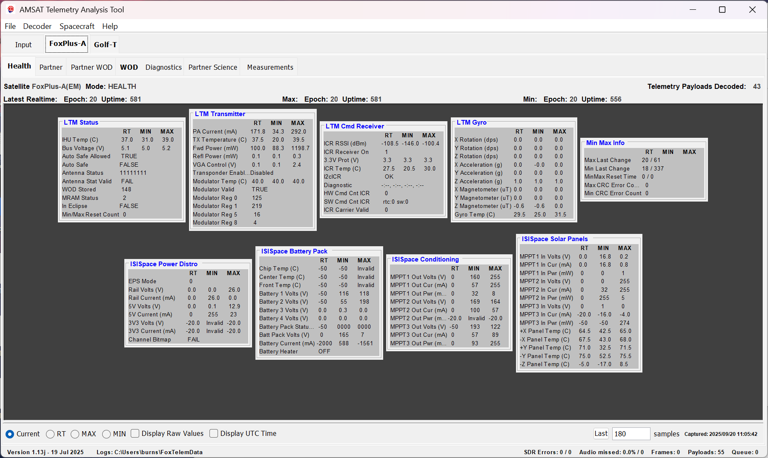
FoxPlus Engineering
FOX
Plus
FoxPlus Flight Software

Slide 16
FoxPlus Engineering
FOX
Plus
FoxPlus-A Summary
FoxPlus-A is ready for Preliminary Design Review (PDR)
And Engineering Model build

Slide 17
FoxPlus Engineering
FOX
Plus
FoxPlus-A Schedule (Tentative)
PDR Nov / Dec 2025
EM System Test Jan 2026
CDR Feb 2026
FM Build & Test Mar – Jun 2026
Final Testing Jul – Sep 2026
Launch! Dec 2026

Slide 18
FoxPlus Engineering
FOX
Plus
The Future for FoxPlus

Slide 19
FoxPlus Engineering
FOX
Plus
FoxPlus-B
FoxPlus-B will be the second and likely the last AMSAT satellite built on the ISIS platform. It will utilize the PacSat board and be a digital satellite with Bulletin Board Service (BBS) capabilities!
Information available at <link>

Slide 20
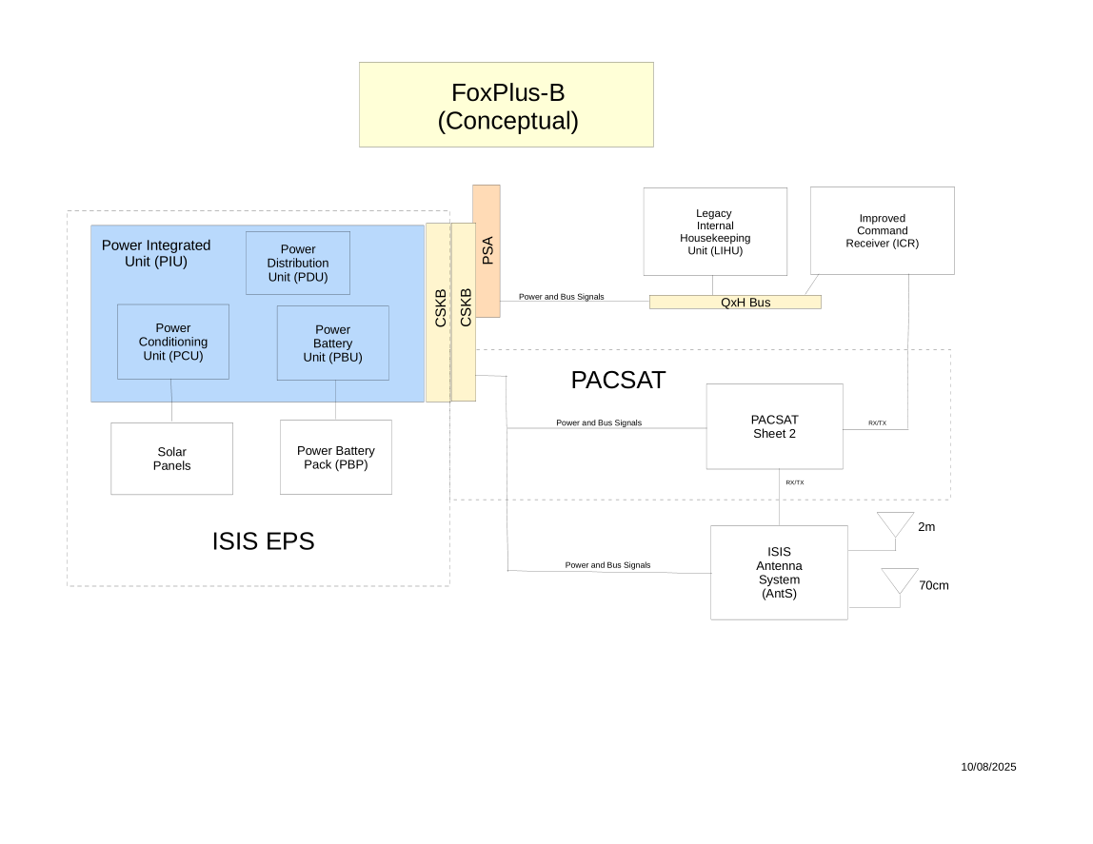
FoxPlus Engineering
FOX
Plus

Slide 21
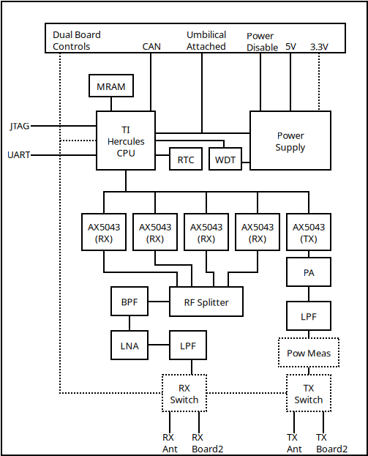
FoxPlus Engineering
FOX
Plus
PACSAT

Slide 22
FoxPlus Engineering
FOX
Plus
FoxPlus-B Schedule (Tentative)
Start Mar 2026
PDR Jun 2026
EM System Test Jun / Jul 2026
CDR Jul 2026
FM Build & Test Jul – Sep 2026
Final Testing Oct - Dec 2026
Launch! Mar 2027

Slide 23
FoxPlus Engineering
FOX
Plus
FoxPlus-C and Beyond
With the demise of the NASA CSLI program, it becomes important to plan for paid launches for our cubesats.
GOLF, being a 3U cubesat will cost approx. $300K / launch.
FoxPlus may be used as a less expensive platform on which to test various technologies.

Slide 24
FoxPlus Engineering
FOX
Plus
FoxPlus-C and Beyond
The FoxPlus-C will have an “in-house” frame, EPS, and solar panels. i.e., we will “roll our own”. The frame design will be based on the work done on the original Fox series of cubesats. The EPS and solar panels will be based on work done on GOLF.

Slide 25
FoxPlus Engineering
FOX
Plus
FoxPlus-C Schedule (WAG)
Start Sep 2026
PDR Apr 2027
EM System Test Apr - Jun 2027
CDR Jul 2027
Final Testing Aug – Oct 2027
Launch! Dec 2027

Slide 26
FoxPlus Engineering
FOX
Plus
FoxPlus-C and Beyond
We may go to a 2U frame for FoxPlus-C. 2U would be capable of more power (more solar cells) and more payloads per satellite.
We would need to be able to turn the payloads / experiments on and off via GS command.
A new inter-board bus and stacking connectors will be needed
ASCENT projects now in development will be flown
AMSAT also has University scientists on staff that would like a means of doing experiments with satellites in LEO

